Slide 1

Security Assessment and Testing

Slide 2

Note
Note that there is significant overlap between this domain and Domain 8: especially regarding application testing.

Slide 3
INTRODUCTION: CISSP EXAM DOMAINS
DOMAINS
WEIGHT
1. Security and Risk Management | 15%
2. Asset Security | 10%
3. Security Architecture and Engineering | 13%
4. Communication and Network Security | 14%
5. Identity and Access Management | 13%
6. Security Assessment and Testing | 12%
7. Security Operations | 13%
8. Software Development Security | 10%

Slide 4
SECURITY ASSESSMENT AND TESTING
Security assessment and testing programs
provides a mechanism for validating the ongoing effectiveness of security controls, with a variety of tools to validate controls:
- vulnerability assessments
- penetration tests, software testing
- audits
- security management tasks
Every organization should have a security assessment
and testing program defined and operational.

Slide 5
ASSESSMENT & TESTING
Vulnerability Assessments vs Penetration Tests
Vulnerability assessments
use automated tools to search for known vulnerabilities in systems, applications, and networks.
flaws may include missing patches, misconfigurations, or faulty code that expose the organization to security risks.
Penetration tests
uses these same tools but supplements them with attack techniques where an assessor attempts to exploit vulnerabilities and gain access to the system.

Slide 6
PENETRATION TESTING
Exercise Types
Red Team
offense
are internal or external entities dedicated to testing the effectiveness of a security program by emulating the tools and techniques of likely attackers in the most realistic way possible.
Blue Team
defense
the internal security team that defends against both real attackers and Red Teams.
Purple Team
process improvement
exists to ensure and maximize the effectiveness of the Red and Blue teams.
White Team
judge / referee
responsible for overseeing an engagement/competition between a Red Team of mock attackers and a Blue Team of actual defenders.

Slide 7

Penetration Testing
Penetration tests are sometimes controversial.
Some argue that a penetration test really tests the skill of the penetration tester, and not the perimeter security of an organization.
If a pen test is successful, there is value to the organization.
But what if the penetration test fails? Did it fail because there is no perimeter risk?
Or did it fail because the penetration tester lacked the skill or the time to complete the test?
Or did it fail because the scope of the penetration test was too narrow?

Slide 8

Assuring Confidentiality, Data Integrity, and System Integrity
Penetration testers must ensure the confidentiality of any sensitive data that is accessed during the test.
If the target of a penetration test is a credit card database, the penetration tester may have no legal right to view or download the credit cards.
Testers will often request that a dummy file containing no regulated or sensitive data (sometimes called a flag) be placed in the same area of the system as the credit card data and protected with the same permissions.

Slide 9
Assuring Confidentiality, Data Integrity, and System Integrity
This risk must be clearly understood by all parties: tests are often performed during change maintenance windows for this reason.
One potential issue that should be discussed before the penetration test commences is the risk of encountering signs of a previous or current successful malicious attack.

Slide 10

Assuring Confidentiality, Data Integrity, and System Integrity
The integrity of the system is at risk in this case, and the penetration tester should end the penetration test, and immediately escalate the issue.
Finally, the final penetration test report should be protected at a very high level: it contains a roadmap to attack the organization.

Slide 11
INTERNAL AND EXTERNAL AUDITS
Conduct or facilitate internal and third-party audits
Security audits
occur when a third party performs an assessment of the security controls protecting an organization’s information assets.
Internal audits
are performed by an organization’s internal staff and are intended for management use.
External audits are performed by a third-party audit firm and are generally intended for the organization’s governing body.
Assume audit is 3rd party unless question says otherwise

Slide 12
SOC Audits
Service Organisation Controls are a series of accounting standards that measure the control of financial information for a service organization.
SOC1 - Also known as the SSAE 18, focuses on financial reporting
Type 1 = Fixed point in time
Type 2 = Considered over at least a 6-month period
SOC2 – Focus more on IT security controls in general
Type 1 = Focuses on Design
Type 2 = Focuses on Operations
SOC3 - Is the same as SOC2 but with sensitive information removed so it can be made available to interested parties. (can be made public)

Slide 13
ASSURANCE CHALLENGES WITH VIRTUALIZATION & CLOUD
The cloud is made possible by virtualization technologies, that enable dynamic environments needed for a global provider platform.
Depending on the cloud architecture employed, a cloud security professional must perform multiple layers of auditing.
To be effective, the auditor must understand the
virtualization architecture of the cloud provider
PROVIDER CSP
CUSTOMER
Audits of controls over the hypervisor will usually be the purview of the CSP
VMs deployed on top of that hardware are usually owned by the customer
Microsoft, Amazon, Google
Cloud consumers

Slide 14
RIGHT TO AUDIT IN THE CLOUD
“
Use of vulnerability scanners and pen testers may be limited by your CSP's terms of service.
Customer should understand the type and frequency of testing the CSP allows.
”
CSPs typically have penetration testing
and scanning "rules of engagement"

Slide 15
CLOUD CONTRACT MANAGEMENT
Contract Clauses
Right to audit
The customer can request the right to audit the service provider to ensure compliance with the security requirements agreed in the contract.
Contracts often written to allow the CSP's standard audits (e.g., SOC 2, ISO 27001 certification) to be used in place of a customer-performed audit.
Metrics
If there are specific indicators that the service provider must provide to the customer, they can be documented in a contract.
Tell you how compliance with the agreement will be measured
Major cloud service providers make SOC 2 Type II (or other report) available on demand as submitting to every customer's audit request is not possible

Slide 16
SECURITY PROCESS DATA
Employment Polices and Practices write
Termination process and background checks
Roles and Responsibilities communicate
Management sets the standard and verbalizes the policy
Security Awareness Training train
Prevents Social Engineering, helps with phishing

Slide 17
SECURITY MANAGEMENT OVERSIGHT
Security managers must perform a variety of activities to retain proper oversight of the information security program.
Log reviews
particularly for administrator activities, ensure that systems are not misused.
Account management reviews
ensure that only authorized users retain access to information systems.
Backup verification the most important!
ensures that the organization’s data protection process is functioning properly.
Key performance and risk indicators
provide a high-level view of security program effectiveness.

Slide 18

Key Risk and Performance Indicators
Key risk and performance indicators help inform goal setting, action planning, performance, and review, among other things.
Key risk indicators (KRI) are forward-looking indicators and aid risk-related decision-making.
Key performance indicators (KPI) are backward-looking indicators and look at historical data for purposes of evaluating if performance targets were achieved.

Slide 19
Key Performance Indicators (KPIs) | Key Risk Indicators (KRIs)
Backward-looking metrics | Forward-looking metrics
Metrics that indicate the achievement of performance targets | Metrics that indicate the level of exposure to operational risk
Provide insights about risk events that have already affected the organization | Help to better monitor potential future shifts in risk conditions or new emerging risks

Slide 20

Synthetic Transactions
Synthetic transactions, or synthetic monitoring, involve building scripts or tools that simulate activities normally performed in an application.
The typical goal of using synthetic transactions/monitoring is to establish expected norms for the performance of these transactions.
These synthetic transactions can be automated to run on a periodic basis to ensure the application is still performing as expected.
These types of transactions can also be useful for testing application updates prior to deployment to ensure the functionality and performance will not be negatively impacted.

Slide 21
SOFTWARE TESTING
Perform software testing to validate code moving into production
Software testing
techniques verify that code functions as designed and does not contain security flaws.
Code review
uses a peer review process to formally or informally validate code before deploying it in production.
Interface testing
assesses the interactions between components and users with API testing, user interface testing, and physical interface testing.

Slide 22
STATIC VS DYNAMIC TESTING
Static vs Dynamic Software Testing
Static software testing
techniques include code reviews, evaluate the security of software without running it by analyzing either the source code or the compiled application.
Dynamic software testing
evaluates the security of software in a runtime environment and is often the only option for organizations deploying applications written by someone else.
"written by someone else" is not a requirement

Slide 23
Software Testing
Unit Testing: Low-level tests of software components, such as functions, procedures or objects
Integration Testing: Testing multiple software components as they are combined into a working system.
Regression Testing: Testing software after updates, modifications, or patches
Installation Testing: Testing software as it is installed and first operated
Acceptance Testing: Testing to ensure the software meets the customer’s operational requirements. When this testing is done directly by the customer, it is called User Acceptance Testing.

Slide 24
Software Testing
Misuse Case Testing - derived from and is the inverse of use case testing; describes the process of executing a malicious act against a system, while use case can be used to describe any action taken by the system
Combinatorial Software Testing - a black-box testing method that seeks to identify and test all unique combinations of software inputs.

Slide 25
FUZZING
Uses modified inputs to test software performance under unexpected circumstances
Modifies known inputs to generate synthetic inputs that may trigger unexpected behavior
Generational fuzzing develops inputs based on models of expected inputs to perform same task
Fuzzing
testing technique

Slide 26

Traceability Matrix
Maps customer requirements to software testing plan

Slide 27
Code Injection
Code injection is a category of attacks in which a malicious actor inserts code into a form field.
For example, an attacker might paste some malicious JavaScript code or Structured Query Language (SQL) queries into a browser-based form field in order to cause the application's back end to execute the code.
If the application does not properly validate and sanitize form input, the code might successfully execute and compromise data.

Slide 28
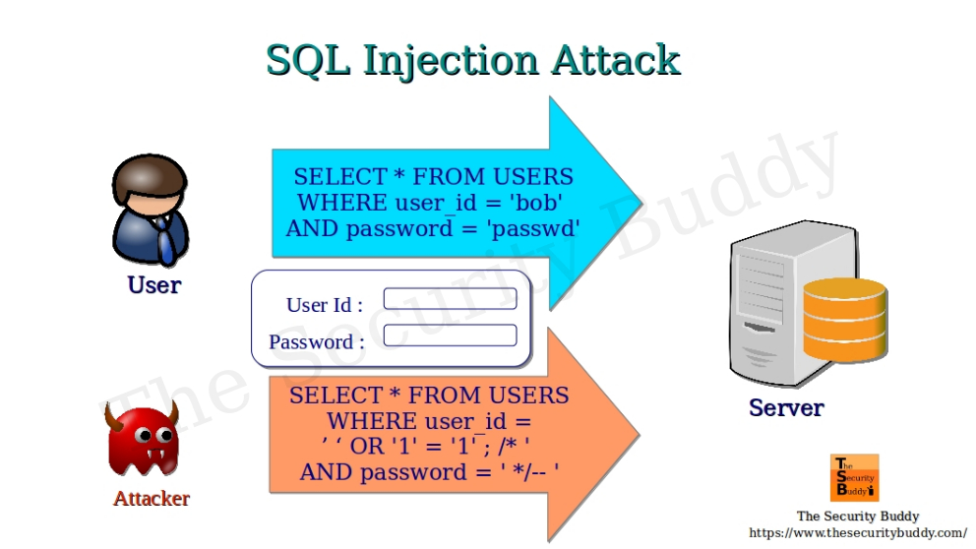

Slide 29
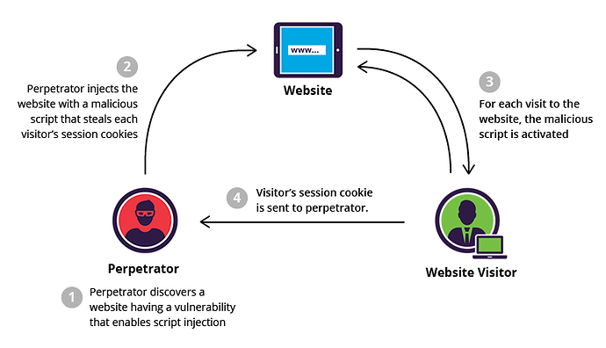
Cross Site Scripting

Slide 30
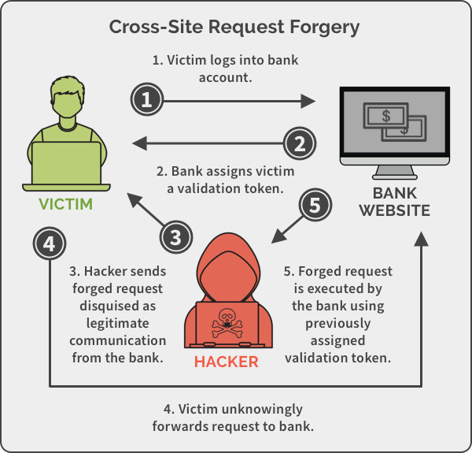

Slide 31
CSRF
To mitigate CSRF attacks, a trusted website can create a random challenge token and associate it with a user's session.
Every user request must include the challenge token so that the trusted site can verify that the request was initiated by the user.

